Slide 1
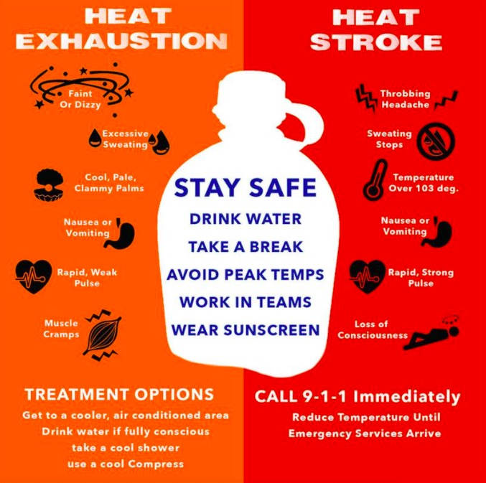
Heat affects everyone. Here are some helpful tips to stay hydrated and cool! However that is not always possible so be sure to know the signs and differences for heat exhaustion and heat stroke!
Heat stroke can set in quickly over the course of 10-15 minutes, or slowly, developing over several hours or days. It’s important to monitor someone for signs of heat exhaustion or heat stroke for a few days after extreme heat exposure.
It’s also possible to experience the sudden onset of heat stroke without any preceding heat exhaustion.

Slide 2
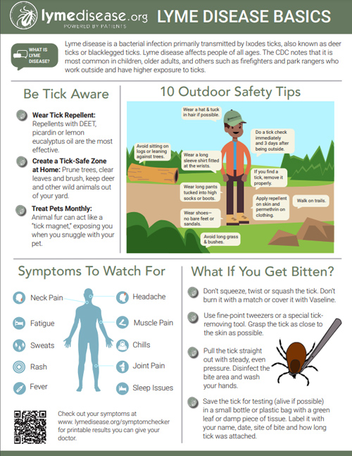
After You Come Indoors
Check your clothing for ticks. Ticks may be carried into the house on clothing. Any ticks that are found should be removed. Tumble dry clothes in a dryer on high heat for 10 minutes to kill ticks on dry clothing after you come indoors. If the clothes are damp, additional time may be needed. If the clothes require washing first, hot water is recommended. Cold and medium temperature water will not kill ticks.
Examine gear and pets. Ticks can ride into the home on clothing and pets, then attach to a person later, so carefully examine pets, coats, and daypacks.
Shower soon after being outdoors. Showering within two hours of coming indoors has been shown to reduce your risk of getting Lyme disease and may be effective in reducing the risk of other tickborne diseases. Showering may help wash off unattached ticks and it is a good opportunity to do a tick check.
Check your body for ticks after being outdoors. Conduct a full body check upon return from potentially tick-infested areas, including your own backyard. Use a hand-held or full-length mirror to view all parts of your body. Check these parts of your body and your child’s body for ticks:
Under the arms
In and around the ears
Inside belly button
Back of the knees
In and around the hair
Between the legs
Around the waist

Slide 3
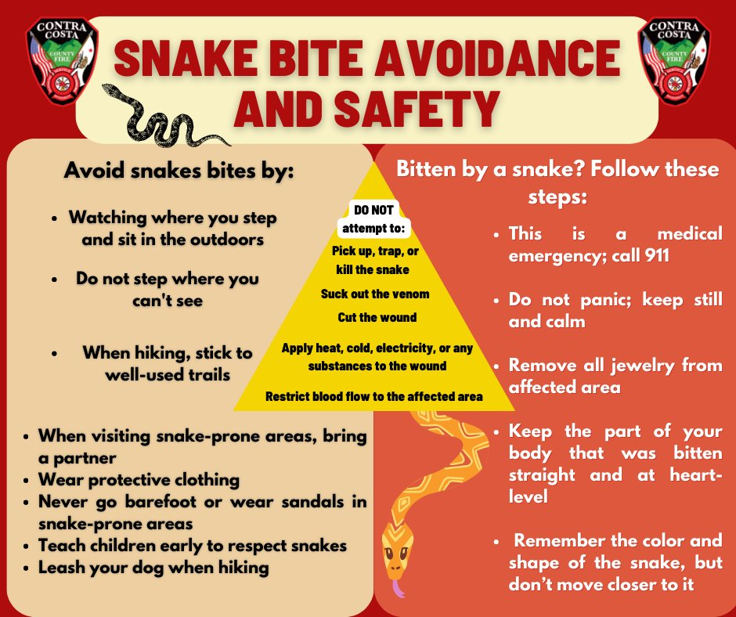
Although most snakes are not aggressive and will slither away at the first hint of human presence, people should still take precautions to lessen the chance of being bitten – particularly in wooded areas around lakes or ponds.
MITIGATING THE HAZARD
• Use the buddy system when walking or running on trails near wooded areas.
• Do not step or put your hands where you cannot see.
• Wear over-the-ankle boots, thick socks and long loose pants, especially when venturing off of heavily used trails.
• Tap ahead of you with a walking stick before entering an area where you can't see your feet. Snakes will try to avoid you if given enough warning.
• When possible, step on logs and rocks, never over them as you may surprise a sheltering snake.
• Avoid walking through dense brush or blackberry thickets.
• Be careful when stepping over a doorstep. Snakes like to crawl along the edge of buildings where they are protected on one side.
• Avoid wandering around in the dark. If you are out at night, always use a flashlight, because most snakes are active on warm nights.
• Never try to pick up a snake, even if it is dead. A snake's reflexes can still cause the snake to strike up to an hour after it has died.
• If you have an encounter with a snake, give it the right-of-way. Do not attempt to kill the snake, just move out of the snake's way
• If you hike often, consider buying a snake bite kit – available from hiking supply stores. Do not use older snake bite kits, such as those containing razor blades and suction bulbs.

Slide 4
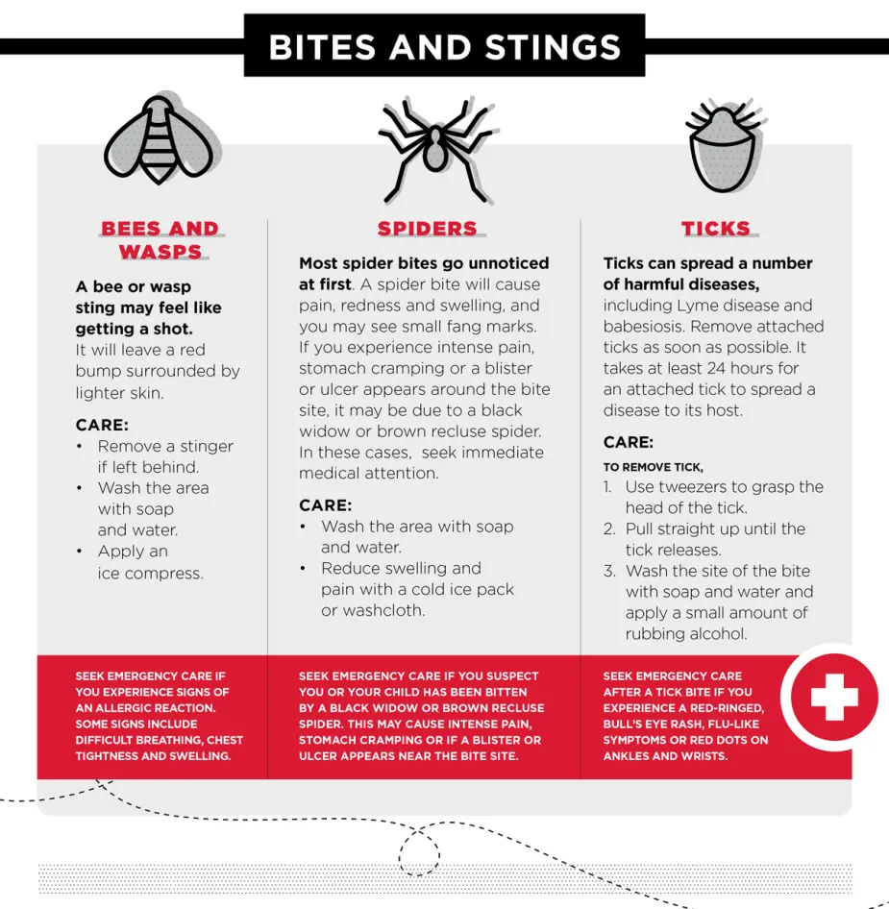
Avoid being bitten:
Clean up clutter in the outdoor job site, garages, and storage sheds.
Avoid stacking crates and other containers against the buildings.
Wear gloves when working near potential spider habitats. Avoid reaching into dark spaces.
Avoid leaving gloves or other clothing on the ground. If you do, shake them out before putting them on.
If you are bitten:
Report the incident to your workplace safety manager.
Identify the spider, if possible. This will help the doctor in diagnosis.
For black widow spider bites, go to the nearest hospital emergency department.
Brown recluse spider bites should be seen by a physician the same day.
Wash the area thoroughly with cool water and mild soap. Do not scrub.
Cold packs may be applied to the bite area. Do not use heat.
If possible, elevate the bite area above the heart level.
Over-the-counter pain relievers may be taken.

Slide 5
Effects of Lead Exposure on Linemen and Remediation Workers
A general consensus exists in the medical community that no amount of lead is safe. Compounding the risk to linemen and abatement workers, lead can enter the body through inhalation or ingestion. When burned, it persists in tiny particles, and casual contact can result in airborne dust particles. Without complete lineman lead protection PPE and disposable clothing, these are conditions workers could suffer from: High Blood Pressure
Miscarriage or Premature Birth
Reduced Sperm Count
Loss of Appetite
Muscle Disorders
Emotional Disorders
Impacted Cognitive Functions
Following lead exposure, the heavy metal remains in the bloodstream for upwards of three months. It’s not uncommon for this toxin to take root in bones, joints, and internal organs. It’s also important to note that current field workers are tasked with making repairs and updates to already tainted telecommunications infrastructure. That means lineman lead protection may not be adequately addressed.
How Should Lead Cable and Soil Abatement be Handled?
Exposure can put workers tasked with abatement in harm’s way, and industry guidelines call for handling the toxin like asbestos. Although not linked to cancer as closely as asbestos, the debilitating effects of lead are well documented. Like asbestos, the material is best mitigated when it can be encapsulated and transferred for processing or appropriate disposal. These are proactive lineman lead protection measures employers can implement to help prevent unnecessary illnesses.
Prepare Work Area: It’s imperative to secure the area before lead abatement and removal begins. When conditions allow, sealing the space off with protective plastic sheeting reduces the amount of escaping airborne particles from contaminating the surrounding area.
Safety Protocols: Outdated lead cables may run through a range of facilities. As workers handle the old and brittle metal, it is likely to flake into airborne dust particles and cling to people and surfaces. Lineman lead protection requires HVAC units, fans, and other air movement equipment to be shuttered.
Handling Lead Cables: Although asbestos mitigation often involves wetting the substance, lead is already dangerously leaching into soil and water. Encasing the toxic metal, whenever practical, reduces dust and skin contact. During the lead preparation phase, lineman safety clothing and respirators are mandated.
Along with the linemen who will directly engage with lead cables and the shavings around the decaying material, soil removal is expected to follow. Backhoe, bulldozer, and dump truck operators are not necessarily used to managing carcinogens of this fashion. Construction workers will also need a complete inventory of lead protective clothing when excavating, transporting, and putting tainted soil in secure locations.
What PPE Do Linemen and Construction Crews Require to Handle Lead?
Occupational Safety and Health Administration (OSHA) mandates that PPE and lineman safety clothing be worn before entering potentially contaminated areas. These lead abatement steps outlined by the U.S. Department of Transportation (DOT) apply to lineman lead protective clothing usage.
Remove and store street clothes.
Adorn reusable safety clothing followed by disposable articles and coveralls overtop.
Put on snug-fitting eye protection and a properly fit-tested respirator.
Put on a disposable hood and headwear after the respirator.
Put on disposable foot coverings.
Lineman lead protection procedures also call for step-by-step clothing and equipment removal. The DOT and safety organizations recommend the following.
Use HEPA vacuums to remove lead dust and shavings.
In a designated space, remove all disposable protective clothing and place it in a sealed plastic bag labeled “lead-contaminated waste.”
Remove the respirator for cleaning.
Health and safety also call for showering before wearing street clothes and leaving the workplace. It’s also prudent to keep casual clothing in a separate area to prevent cross-contamination. Even tiny amounts of lead can negatively impact the development of small and/or unborn children.
Lineman Safety Clothing Needed to Cleanup 2,000 Lead Telecom Cables (int-enviroguard.com)

Slide 6
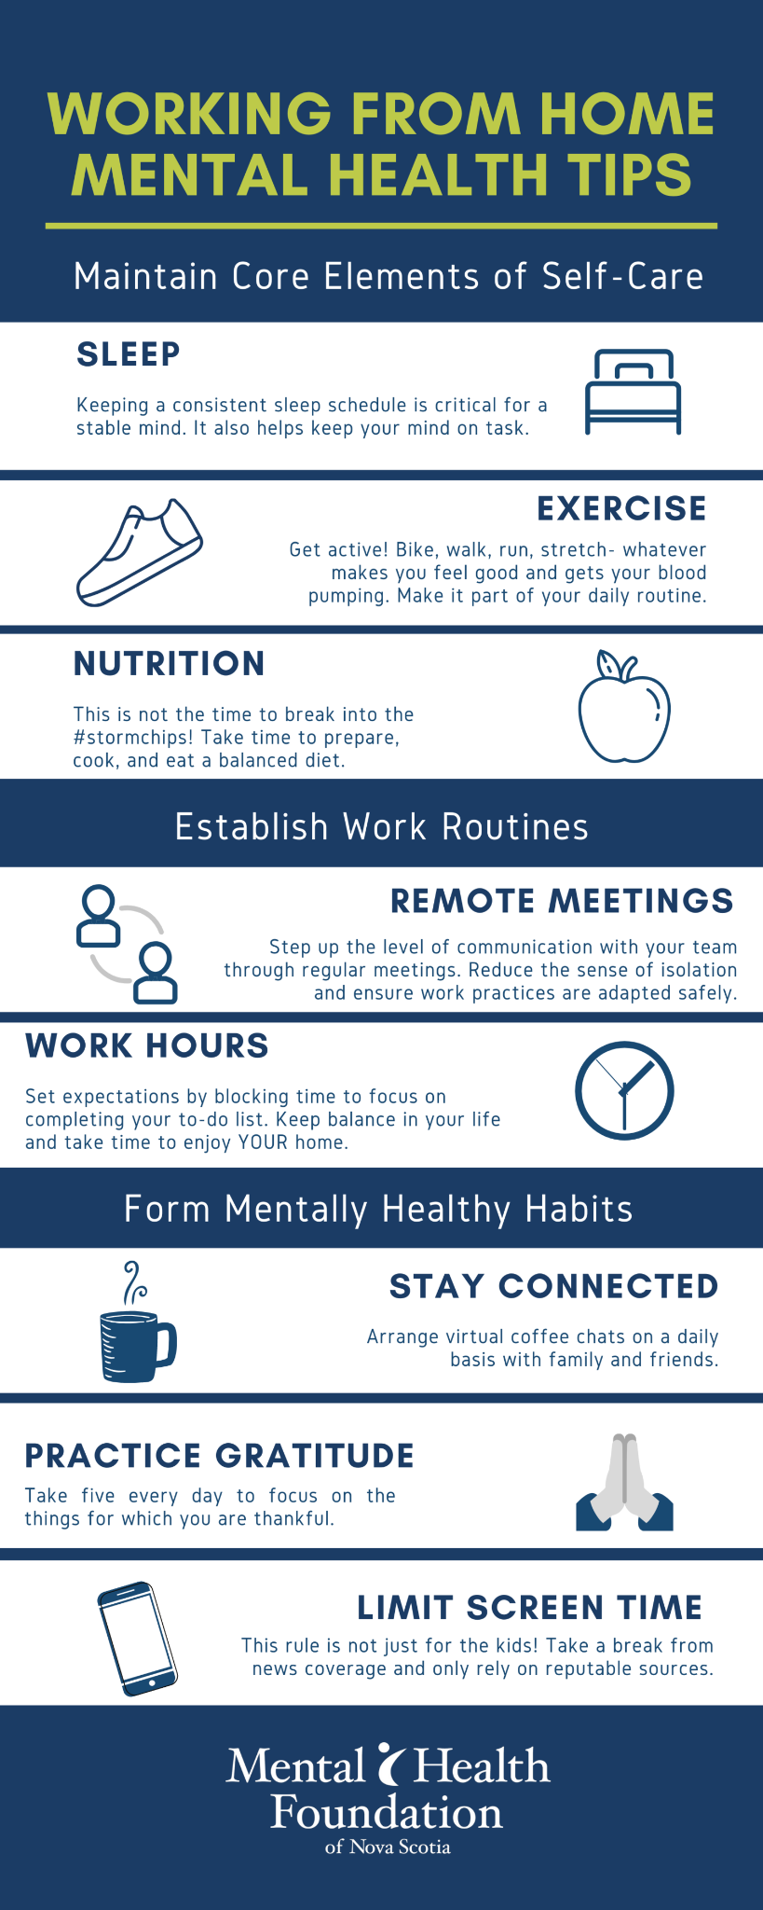
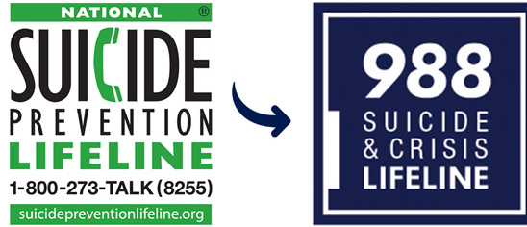
It’s important you’re maintaining your mental and physical wellbeing while working from home. Attached are articles on maintaining a mental and physical wellbeing and the link to our facebook page!
Maintaining Your Mental Wellbeing While Working Home (internationalsos.com)
6 simple tips to tackle working from home - Every Mind Matters - NHS (www.nhs.uk)
Tips to Stay Mentally Well While Working From Home... - Active Minds
A Practical Guide to Self-care When Working from Home - Mental Health First Aid
8 tips to try to maintain health while working from home (medicalnewstoday.com)
10 Easy Tips for Staying Healthy While Working from Home | TeamBonding
Best Tips For Staying Healthy While Working From Home (forbes.com)
Working From Home - Penn Medicine
CWA Local 2204 | Facebook

